Slide 1
Chapter 3: Everything Generates Data
IOT CƠ BẢN
502068

Slide 2
Ghi chú về bản quyền
Toàn bộ nội dung bài giảng là của CISCO, sinh viên có quyền tải về, lưu trữ, in ấn, tham khảo cho mục đích học tập. Sinh viên không được phát hành lại hay thay đổi nội dung slide nếu chưa có sự đồng ý của chủ sở hữu.
Phần ghi chú ở cuối slide (nếu có) là do các thầy cô ghi chú lại trong quá trình giảng dạy.

Slide 3
Chapter 3: Everything Generates Data
Introduction to the Internet of Things v2.0
Notes:
Cisco Networking Academy Program
Introduction to the Internet of Things
Chapter 3: Everything Generates Data

Slide 4
Chapter 3 - Sections & Objectives
3.1 Big Data
Explain the concept of Big Data.
Describe the sources of Big Data.
Explain the challenges and solutions to Big Data storage.
Explain how Big Data analytics are used to support Business.
Notes:
3
Cisco Networking Academy Program
Introduction to the Internet of Things
Chapter 1: Everything is Connected

Slide 5
3.1 Big Data
Notes:
3 – Everything Generates Data
3.1 – Big Data

Slide 6
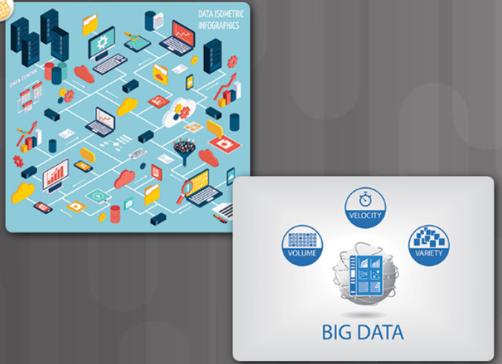
What is Big Data? What is Big Data?
Data is information that comes from a variety of sources, such as people, pictures, text, sensors, web sites and technology devices.
Three characteristics that indicate an organization may be dealing with Big Data:
A large amount of data that increasingly requires more storage space (volume).
An amount of data that is growing exponentially fast (velocity).
Data that is generated in different formats (variety).
Examples of data amounts collected by sensors:
One autonomous car can generate 4,000 gigabits (Gb) of data per day.
One smart connected home can produce as much as 1 gigabyte (GB) of information a week.
Notes:
3.1 – Big Data
3.1.1 – What is Big Data?
3.1.1.1 – What is Big Data?

Slide 7
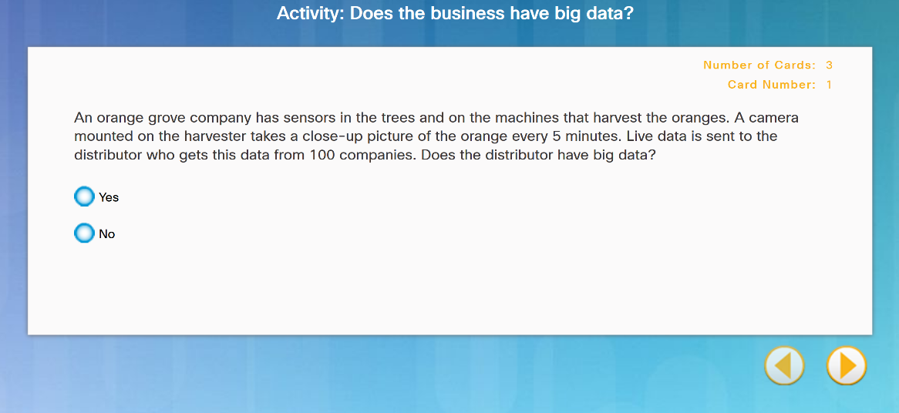
What is Big Data? Does the Business Generate Big Data?
Notes:
3.1 – Big Data
3.1.1 – What is Big Data?
3.1.1.2 – Does the Business Generate Big Data?
3.1.1.3 Activity Volume/Velocity/Variety

Slide 8
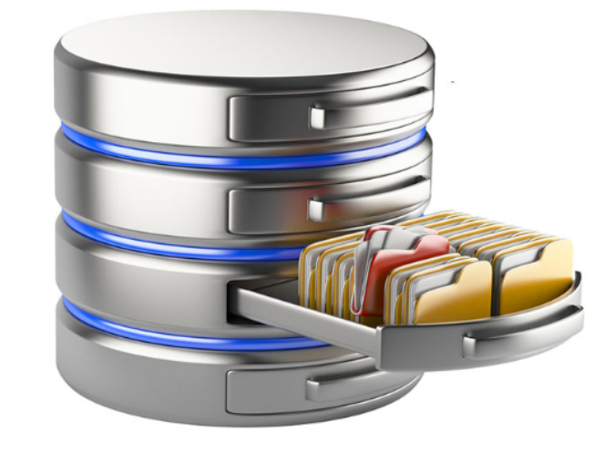
What is Big Data? Large Datasets
Companies do not necessarily have to generate their own Big Data.
There are sources of free data sets available, ready to be used and analyzed.
Notes:
3.1 – Big Data
3.1.1 – What is Big Data?
3.1.1.4 – Large Datasets

Slide 9
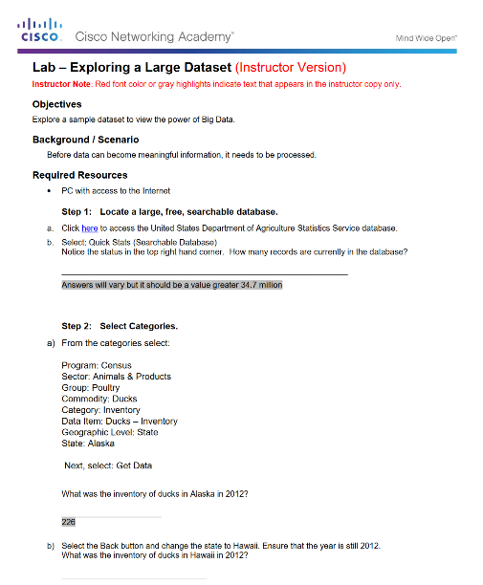
What is Big Data? Lab – Database Search
Notes:
3.1 – Big Data
3.1.1 – What is Big Data?
3.1.1.5 – Lab – Explore a Large Dataset
3.1.1.6 - Topic Assessment

Slide 10
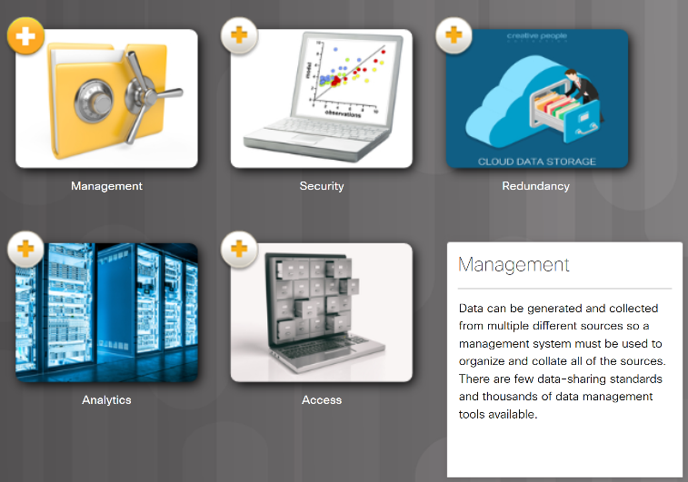
Where is Big Data Stored? What are the Challenges of Big Data?
IBM’s Big Data estimates conclude that “each day we create 2.5 quintillion bytes of data”.
Five major storage problems with Big Data:
Management
Security
Redundancy
Analytics
Access
Notes:
3.1 – Big Data
3.1.2 – Where is Big Data Stored?
3.1.2.1 – What are the Challenges of Big Data?

Slide 11
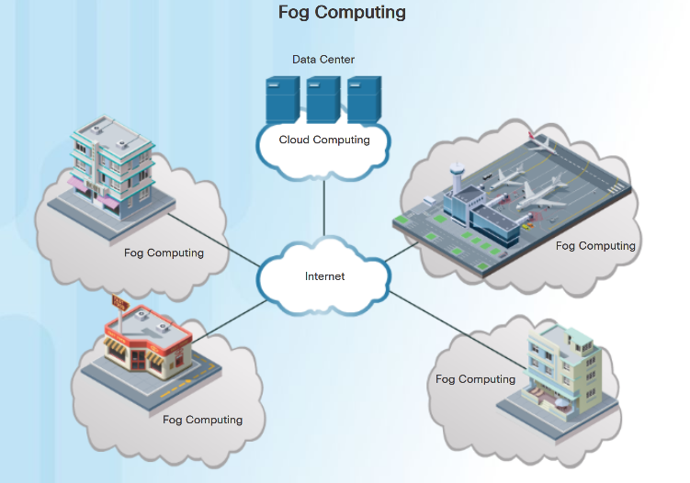
Where is Big Data Stored? Where Can We Store Big Data?
Big data is typically stored on multiple servers, in data centers.
Fog computing utilizes end-user clients or “edge” devices to do a substantial amount of the pre-processing and storage.
Data from that pre-processed analysis can be fed back into the companies’ systems to modify processes if required.
Communications to and from the servers and devices is quicker and requires less bandwidth than constantly going out to the cloud.
Notes:
3.1 – Big Data
3.1.2 – Where is Big Data Stored?
3.1.2.2 – Where Can We Store Big Data?

Slide 12

Where is Big Data Stored? The Cloud and Cloud Computing
The cloud is a collection of data centers or groups of connected servers.
Cloud services for individuals include:
Storage of data, such as pictures, music, movies, and emails.
Access many applications instead of downloading onto local device.
Access data and applications anywhere, anytime, and on any device.
Cloud Services for an Enterprise include:
Access to organizational data anywhere and at any time.
Streamlines the IT operations of an organization.
Eliminates or reduces the need for onsite IT equipment, maintenance, and management.
Reduces cost for equipment, energy, physical plant requirements, and personnel training needs.
Notes:
3.1 – Big Data
3.1.2 – Where is Big Data Stored?
3.1.2.3 – The Cloud and Cloud Computing

Slide 13
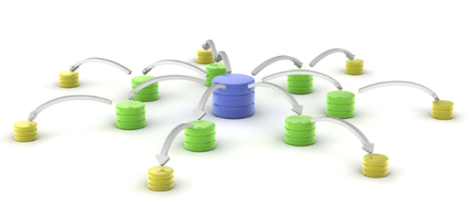
Where is Big Data Stored? Distributed Processing
Distributed data processing takes the large volume of data and breaks it into smaller pieces.
These smaller pieces are distributed in many locations to be processed by many computers.
Each computer in the distributed architecture analyzes its part of the Big Data picture (horizontal scaling).
Hadoop was created to deal with these Big Data volumes. It has two main features that has made it the industry standard:
Scalability - Larger cluster sizes improve performance and provide higher data processing capabilities.
Fault tolerance – Hadoop automatically replicates data across clusters.
Notes:
3.1 – Big Data
3.1.2 – Where is Big Data Stored?
3.1.2.4 – Distributed Processing
3.1.2.5 - Topic Assessment

Slide 14
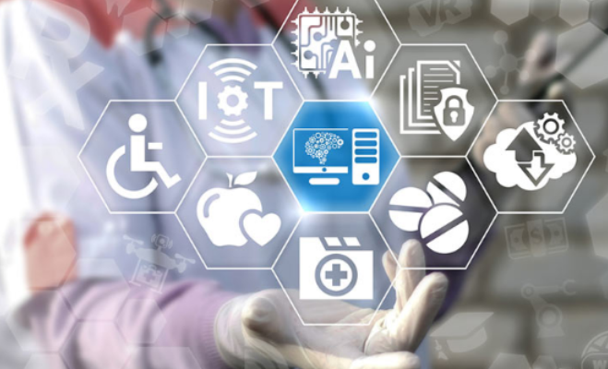
Supporting Business with Big Data Why Do Businesses Analyze Data?
Data analytics allows businesses to better understand the impact of their products and services, adjust their methods and goals, and provide their customers with better products faster.
Value comes from two primary types of processed data, transactional and analytical.
Transactional information is captured and processed as events happen.
Used to analyze daily sales reports and production schedules to determine how much inventory to carry.
Analytical information supports managerial analysis tasks like determining whether the organization should build a new manufacturing plant.
Notes:
3.1 – Big Data
3.1.3 – Supporting Business with Big Data
3.1.3.1 – Why Do Businesses Analyze Data?

Slide 15
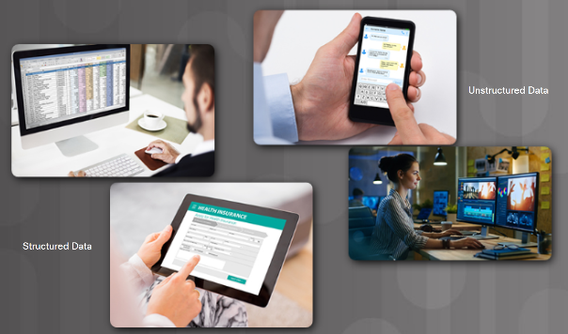
Supporting Business with Big Data Sources of Information
Data originates from sensors and anything that has been scanned, entered, and released to the Internet.
Collected data can be categorized as structured or unstructured.
Structured data is created by applications that use “fixed” format input such as spreadsheets. May need to be manipulated into a common format such as CSV.
Unstructured data is generated in a “freeform” style such as audio, video, web pages, and tweets.
Examples of tools to prepare unstructured data for processing are:
“Web scraping” tools automatically extract data from HTML pages.
RESTful application program interfaces (APIs).
Notes:
3.1 – Big Data
3.1.3 – Supporting Business with Big Data
3.1.3.2 – Sources of Information

Slide 16

Supporting Business with Big Data Data Visualization
Data mining is the process of turning raw data into meaningful information.
The mined data must be analyzed and presented to managers and decision makers.
Determining the best visualization tools to use will vary based on the following:
Number of variables
Number of data points in each variable
Is the data representing a timeline
Items require comparisons
Popular charts include line, column, bar, pie, and scatter.
Notes:
3.1 – Big Data
3.1.3 – Supporting Business with Big Data
3.1.3.3 – Data Visualization

Slide 17
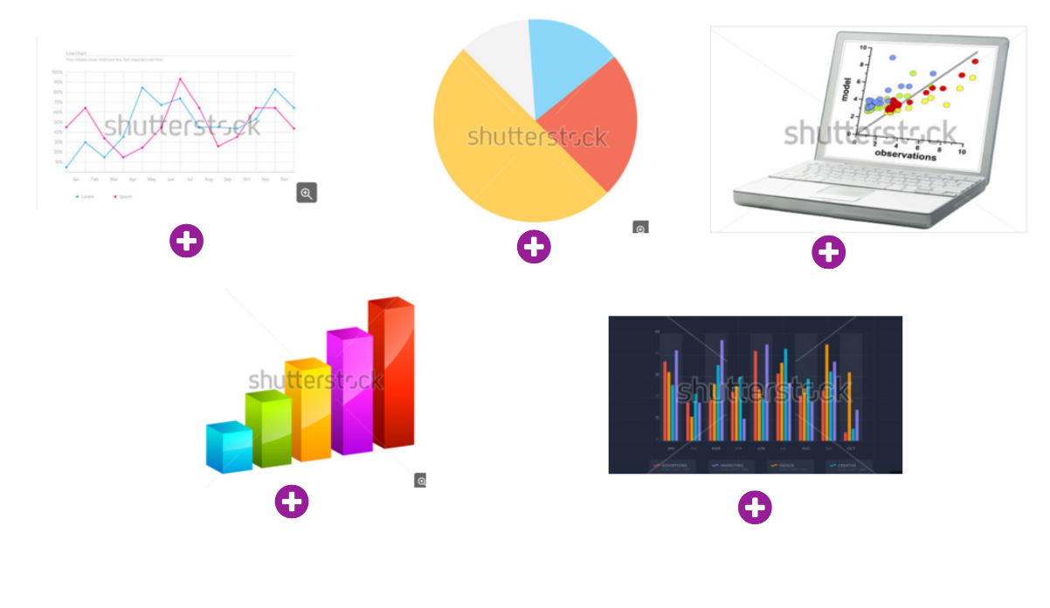
Supporting Business with Big Data Chart Types
Notes:
3.1 – Big Data
3.1.3 – Supporting Business with Big Data
3.1.3.4 – Chart Types
3.1.3.5 – Activity – Explore Analyzed Data

Slide 18
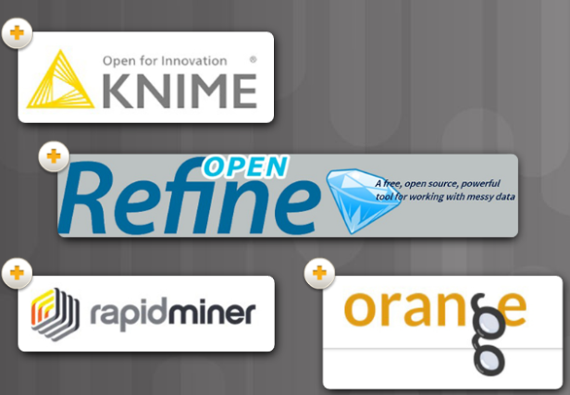
Supporting Business with Big Data Analyzing Big Data for Effective Use in Business
Data analysis is the process of inspecting, cleaning, transforming, and modeling data to uncover useful information.
Having a strategy helps a business determine the type of analysis required and the best tool to do the analysis.
Tools and applications range from using an Excel spreadsheet or Google Analytics for small to medium data samples, to the applications dedicated to manipulating and analyzing really big datasets.
Examples include Knime, OpenRefine, Orange, and RapidMiner.
Notes:
3.1 – Big Data
3.1.3 – Supporting Business with Big Data
3.1.3.6 – Analyzing Big Data for Effective Use in Business

Slide 19
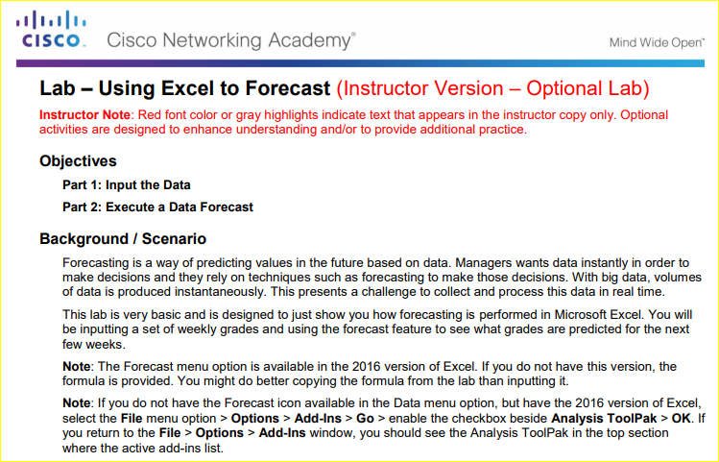
Supporting Business with Big Data Excel lab: Forecasting
Notes:
3.1 – Big Data
3.1.3 – Supporting Business with Big Data
3.1.3.7 – Lab – Using Excel to Forecast
3.1.3.8 – Topic Assessment

Slide 20
3.2 Chapter Summary
Notes:
3 – Everything Generates Data
3.2 - Summary

Slide 21
Chapter Summary Summary
Three characteristics of Big Data:
large amount of data that increasingly requires more storage space (volume)
growing exponentially fast (velocity)
generated in different formats (variety)
Fog computing utilizes end-user clients or “edge” devices to do pre-processing and storage.
Designed to keep the data closer to the source for pre-processing.
The cloud is a collection of data centers or groups of connected servers giving anywhere, anytime access to software, storage, and services using a browser interface.
Provide increased data storage and reduce the need for onsite IT equipment, maintenance, and management.
Distributed data processing takes large volumes of data from a source and breaks it into smaller pieces and distributes to many locations to be processed.
Each computer in the distributed architecture analyzes its part of the Big Data picture.
Notes:
3 – Everything Generates Data
3.2 – Summary

Slide 22
Chapter Summary Summary (Cont.)
Businesses gain value by collecting and analyzing data to understand the impact of their products and services, adjust their methods and goals, and provide their customers with better products faster.
Structured data is created by applications that use “fixed” format input such as spreadsheets or medical forms.
Unstructured data is generated in a “freeform” style such as audio, video, web pages, and tweets.
Both forms of data need to be manipulated into a common format to be analyzed.
Data mining is the process of turning raw data into meaningful information by discovering patterns and relationships in large data sets.
Data visualization is the process of taking the analyzed data and using charts such as line, column, bar, pie, or scatter to present meaningful information.
Notes:
3 – Everything Generates Data
3.2 – Summary

Slide 24
Chapter 4: Everything Can be Automated
Introduction to the Internet of Things v2.0
Notes:
Cisco Networking Academy Program
Introduction to the Internet of Things
Chapter 4: Everything Can be Automated

Slide 25
Chapter 4 - Sections & Objectives
4.1 What Can be Automated?
Explain how digitization allows business processes to embrace automation.
Describe automation
Explain how artificial intelligence and machine learning impact automation.
Explain how intent-based networking adapts to changing business needs.
Notes:
24
Cisco Networking Academy Program
Introduction to the Internet of Things
Chapter 4: Everything Can be Automated

Slide 26
4.1 What Can Be Automated?
Notes:
4 – Everything Can be Automated
4.1 – What Can Be Automated

Slide 27
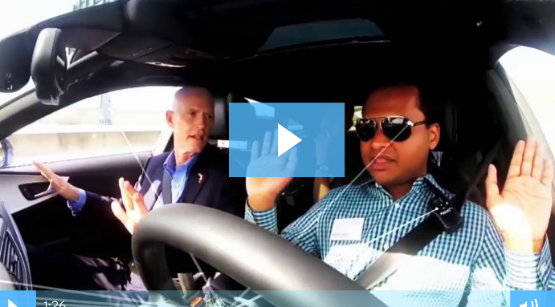
Automation What is Automation?
Automation is any process that is self-driven, reduces,and eventually eliminates, the need for human intervention.
The IoT opens up a new world in which tasks previously requiring human intervention can become automated.
Automation
Robots are used in dangerous conditions such as mining, firefighting, and cleaning up industrial accidents
used in automated assembly lines.
self-serve checkouts at stores
automatic building environmental controls
autonomous cars and planes.
Notes:
4.1 – What Can Be Automated?
4.1.1 – Automation
4.1.1.1 – What is Automation?

Slide 28
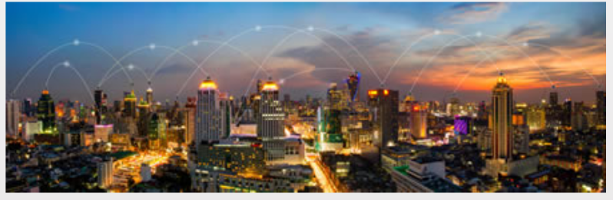
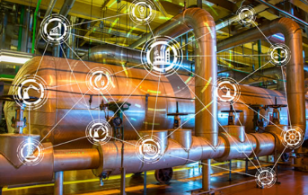
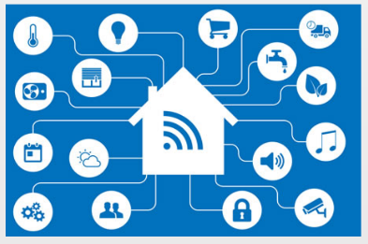
Automation How is Automation being Used?
Smart Home Automation
Smart Buildings
Industrial IoT and Smart Factories
Smart Cities
Smart Grid
Smart Cars
Stores and Services
Medical Diagnosis and Surgery
Aircraft Auto-Pilot
Notes:
4.1 – What Can Be Automated?
4.1.1 – Automation
4.1.1.2 – How is Automation being Used?

Slide 29
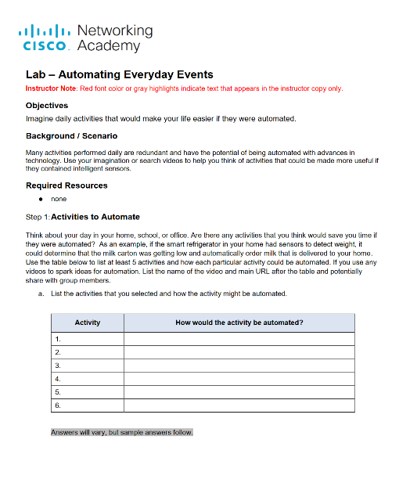
Automation Lab – Automating Everyday Events
Notes:
4.1 – What Can Be Automated?
4.1.1 – Automation
4.1.1.3 – Lab – Automating Everyday Events

Slide 30
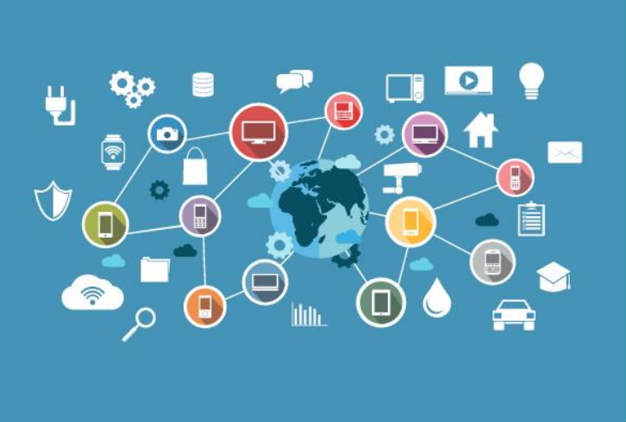
Automation When Things Start to Think
Many devices now incorporate smart technology to alter their behavior under certain circumstances.
can be as simple as a smart appliance lowering its power consumption during periods of peak demand or as complicated as a self-driving car.
Whenever a decision or course of action is taken by a device based on an outside piece of information, then that device is referred to as a smart device.
Notes:
4.1 – What Can Be Automated?
4.1.1 – Automation
4.1.1.4 – When Things Start to Think
4.1.1.5 - Activity – Automation or Not Automation

Slide 31
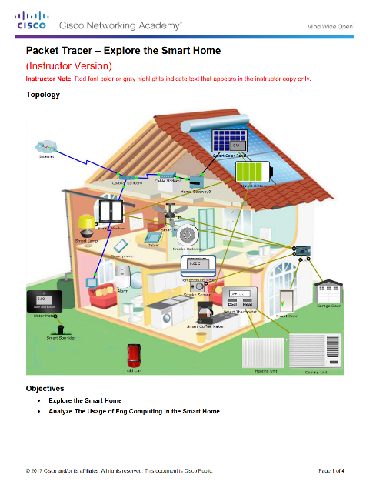
Automation Packet Tracer– Explore the Smart Home
Notes:
4.1 – What Can Be Automated?
4.1.1 – Automation
4.1.1.6 – Packet Tracer– Explore the Smart Home
4.1.1.7 – Topic Assessment

Slide 32
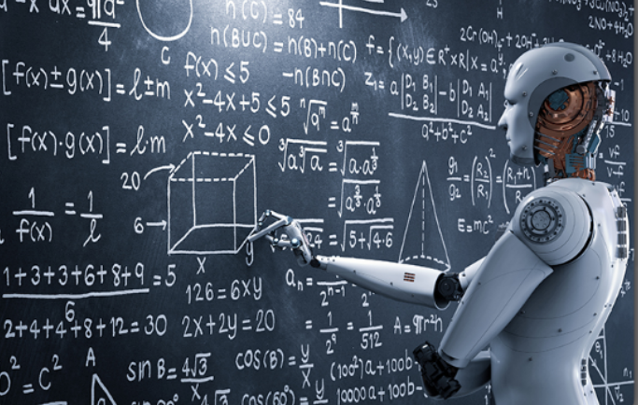
Artificial Intelligence (AI) and Machine Learning (ML) What Is Artificial Intelligence and Machine Learning?
Artificial Intelligence (AI) is the intelligence demonstrated by machines.
AI uses intelligent agents that can perceive their environment and make decisions.
AI refers to systems that mimic cognitive functions normally associated with human minds such as learning and problem solving.
Machine Learning (ML) is a subset of AI that uses statistical techniques to give computers the ability to “learn” from their environment.
This enables computers to improve on a particular task without being specifically programmed for that task.
Notes:
4.1 – What Can Be Automated?
4.1.2 – Artificial Intelligence (AI) and Machine Learning (ML)
4.1.2.1 – What Is Artificial Intelligence and Machine Learning?

Slide 33
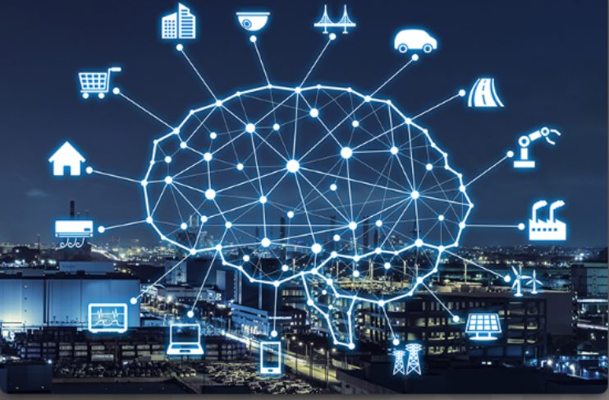
Artificial Intelligence (AI) and Machine Learning (ML) ML and the IoT
Common uses of ML technology include:
Speech Recognition – used in digital assistants.
Product Recommendation - Systems build up a customer profile and recommend products or services based on previous patterns.
Shape Recognition - Programs exist that allow crude hand-drawn diagrams and notes to be converted to more formal diagrams and text.
Credit Card Fraud Detection - A profile is constructed about the purchasing patterns of a client.
Facial Recognition
Notes:
4.1 – What Can Be Automated?
4.1.2 – Artificial Intelligence (AI) and Machine Learning (ML)
4.1.2.2 – ML and the IoT

Slide 34
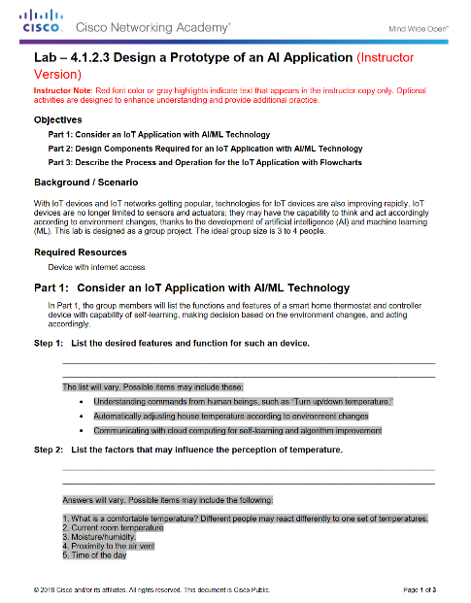
Automation Packet Tracer– Explore the Smart Home
Notes:
4.1 – What Can Be Automated?
4.1.2 – Automation
4.1.2.3 – Packet Tracer – Explore a Smart Home
4.1.2.4 – Topic Assessment

Slide 35
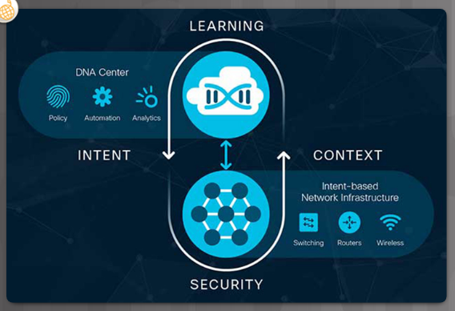
Intent-Based Networking What is Intent-Based Networking (IBN)
IT industry creating a systematic approach to tie infrastructure management to business intent (IBN).
Business network must seamlessly and securely integrate IoT devices, cloud-based services, and remote offices.
Network must secure these new digital initiatives from the ever-changing threat landscape.
Network must be responsive enough to quickly adapt to changes to security policies and procedures, business services and applications, and operational policies.
Notes:
4.1 – What Can Be Automated?
4.1.3 – Intent-Based Networking
4.1.3.1 – What is Intent-Based Networking (IBN)

Slide 36
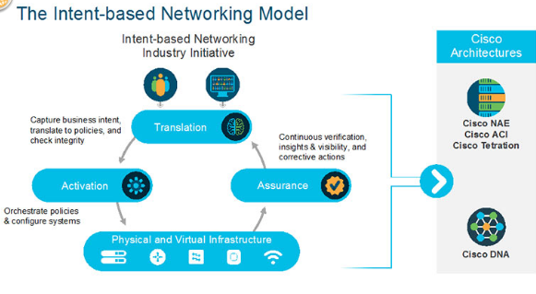
Intent-Based Networking How are ML, AI, and IBN Linked?
Intent-based networking harnesses the power of automation, AI and ML to control the function of a network to accomplish a specific purpose, or intent.
Network is able to translate the intent into policies and then use automation to deploy the appropriate configurations required.
Intent-based networking model consists of three key elements:
Assurance - end-to-end verification of network-wide behavior.
Translation - ability to apply business intent to network configuration.
Activation - occurs after the intent has been specified and the policies created.
Notes:
4.1 – What Can Be Automated?
4.1.3 – Intent-Based Networking
4.1.3.2 – How are ML, AI, and IBN Linked?

Slide 37
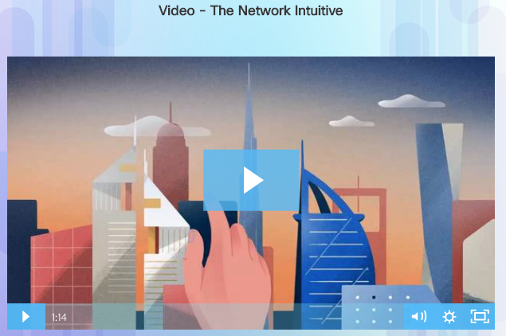
Intent-Based Networking Use Cases for Intent-Based Networking
Intent-based networking allows the company to focus on business goals.
Provides an automated system that understands what the organization needs and then makes it happen.
Cisco Digital Network Architecture (Cisco DNA) is an example of an intent-based network.
Open, extensible, software-driven architecture.
Accelerates and simplifies enterprise network operations, while lowering costs and reducing risks.
https://www.cisco.com/c/en/us/solutions/enterprise-networks/index.html
Notes:
4.1 – What Can Be Automated?
4.1.3 – Intent-Based Networking
4.1.3.3 – Use Cases for Intent-Based Networking

Slide 38
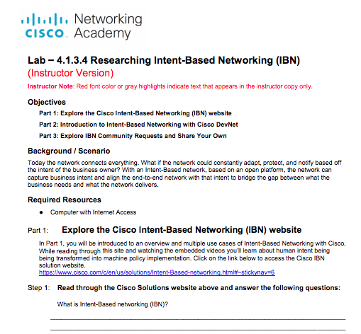
Intent-Based Networking Lab – Researching Intent-Based Networking (IBN)
Notes:
4.1 – What Can Be Automated?
4.1.3 – Intent-Based Networking
4.1.3.4 – Lab – Researching Intent-Based Networking (IBN)
4.1.3.5 – Topic Assessment

Slide 39
4.2 Chapter Summary
Notes:
4 – Everything Can Be Automated
4.2 - Summary

Slide 40
Chapter Summary Summary
.
Notes:
4 – Everything Can Be Connected
4.2 – Summary
4.2.1.1 - Summary

